Slide 1
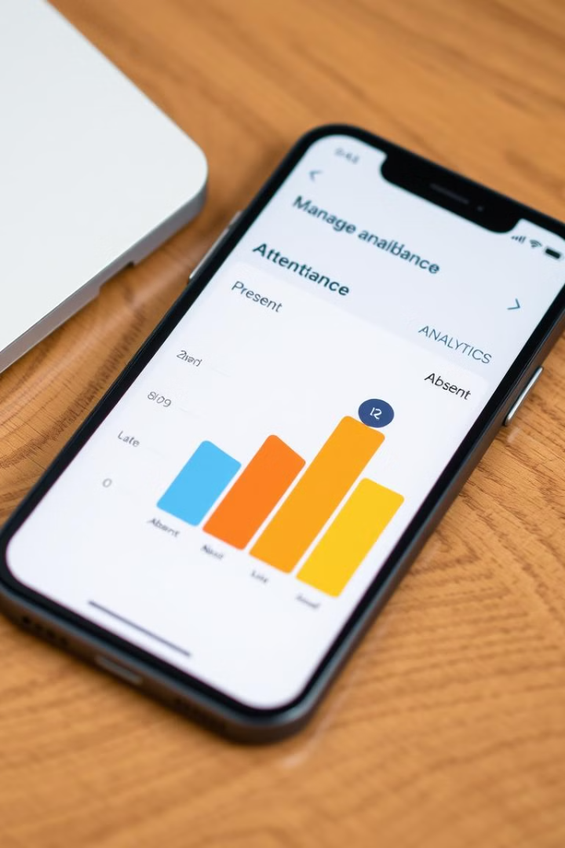
Mobile-Based Attendance Management System
For College of Agriculture, Vellanikkara, Thrissur
PRESENTED BY :
FUHAD SANEEN K
MCA 23-127

Slide 2
Introduction
Current methods are often manual or semi-automated, leading to inefficiencies.
This project aims to develop a mobile application to streamline attendance tracking and viewing.
Attendance management is crucial in academic institutions.

Slide 3
RELATED WORKS
Sl. No | Title | Technology/Algorithm Used | Pros | Cons
1 | A. Kumar and B. Singh, "Smart Attendance Management System Using Mobile Applications," IEEE Transactions on Education Technology, vol. 5, no. 3, pp. 123-130, Mar. 2021 | Mobile Application, Real-Time Attendance, Authentication | - Efficient attendance tracking - Reduces manual errors - Real-time data management | - Scalability challenges - High setup costs - Dependence on mobile devices
2 | J. Smith and A. Doe, "Cloud-Based Attendance System Using Mobile Apps," IEEE Journal of Educational Computing, vol. 7, no. 2, pp. 98-105, Apr. 2022 | Cloud Computing, Mobile Application | - Real-time synchronization - Remote monitoring and updates - Scalable architecture | - Privacy concerns - Requires constant internet connectivity
3 | M. Chen and L. Zhang, "Mobile Application Development for Academic Attendance Tracking," IEEE International Conference on Mobile Computing, pp. 45-52, June 2021 | Cross-Platform Mobile App Development, QR Code, Geolocation | - User-friendly interface - Prevents proxy attendance - Compatible with multiple platforms | - Requires QR code scanning hardware - Geolocation tracking may have privacy issues

Slide 4
Sl. No | Title | Technology/Algorithm Used | Pros | Cons
4 | S. Patel and R. Gupta, "Digital Transformation in Education: Implementing Mobile-Based Attendance Systems," IEEE Conference on Educational Technology Integration, pp. 210-217, Aug. 2022 | Mobile Application, Data Analytics, Automated Notifications | - Reduces manual intervention - Improved tracking of attendance patterns - Automated notifications | - Resistance from stakeholders - Technical issues during deployment
5 | P. R. Sharma et al., "A Mobile-Based Attendance System Using Facial Recognition," International Journal of Computer Applications, vol. 178, no. 3, pp. 10-15, Aug. 2021 | Facial Recognition, Mobile Application | - High accuracy in attendance marking - No need for manual intervention | - Requires high-quality camera hardware - Privacy concerns with facial data

Slide 5

Problem Statement
Traditional attendance management systems are prone to errors, time-consuming, lack data accessibility, are error-prone, and require constant internet connectivity, limiting offline functionality
Manual Processes
Data Accessibility
Prone to errors and time-consuming.
Limited access to attendance records.
Error-Prone
Lack offline functionality
Difficult to ensure accuracy in records.
require constant internet connectivity, limit offline usability

Slide 6
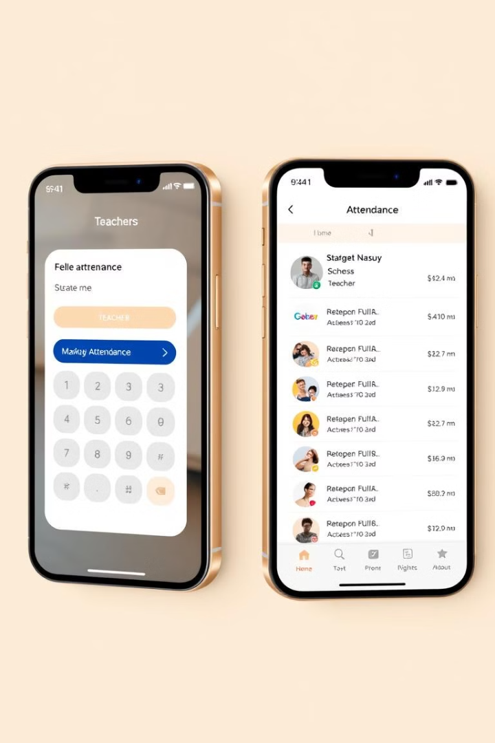
Proposed Solution
1
Mobile-Based Application
2
Real-Time Access
Students view attendance records in real-time.
Teachers mark attendance quickly and efficiently.
3
Secure Storage
Attendance data is stored securely in a cloud-based database.

Slide 7
Methodology
1
Secure login for students and teachers.
2
Teachers record attendance through the app.
3
Students access their attendance records.
4
Attendance reports are auto-generated and accessible.

Slide 8
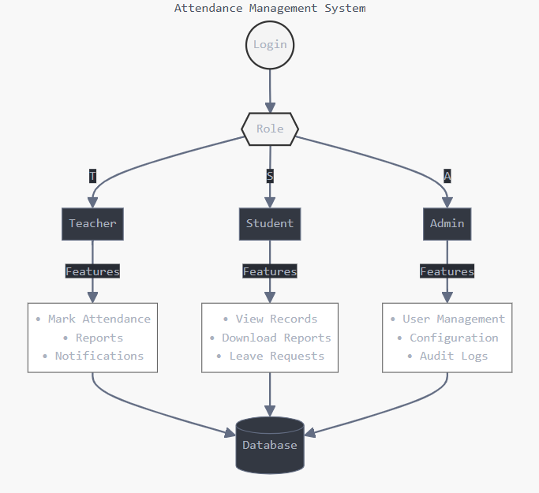

Slide 9
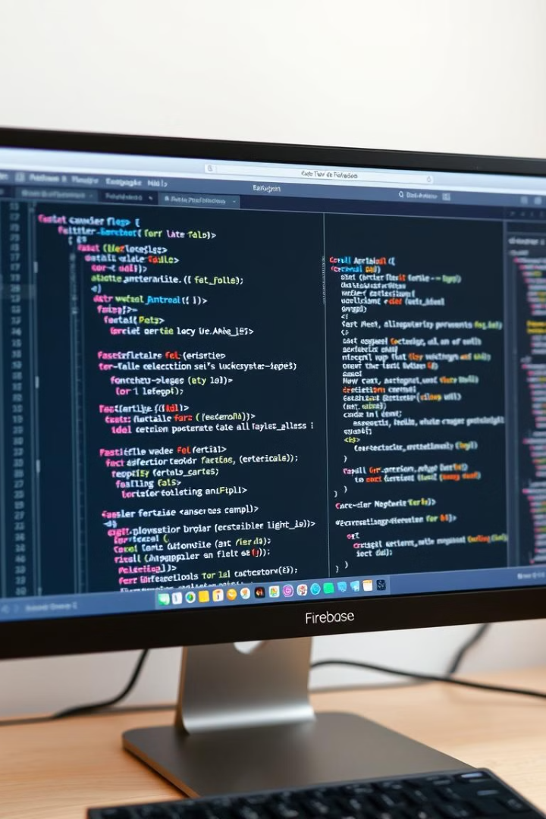




Technologies Used
Flutter
Flask
Cross-platform mobile app development.
API development.
Firebase
Firebase Authentication
Real-time data storage and retrieval.
Secure login.

Slide 10
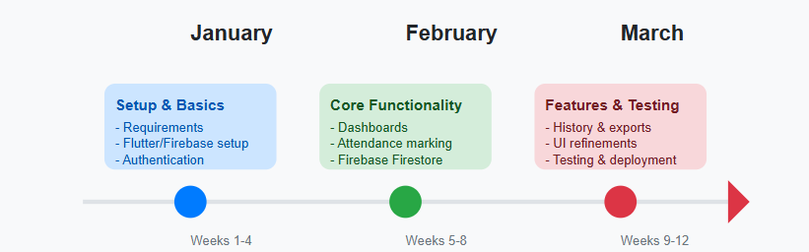
TIMELINE

Slide 11
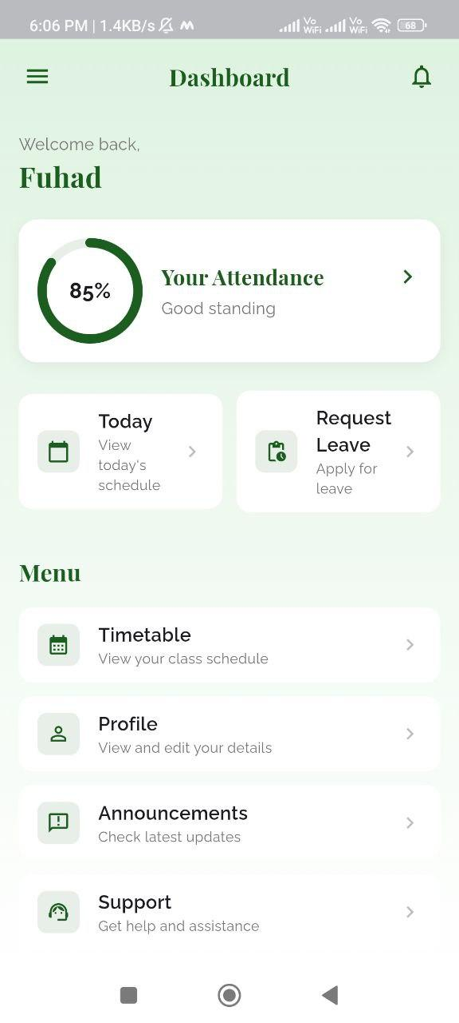
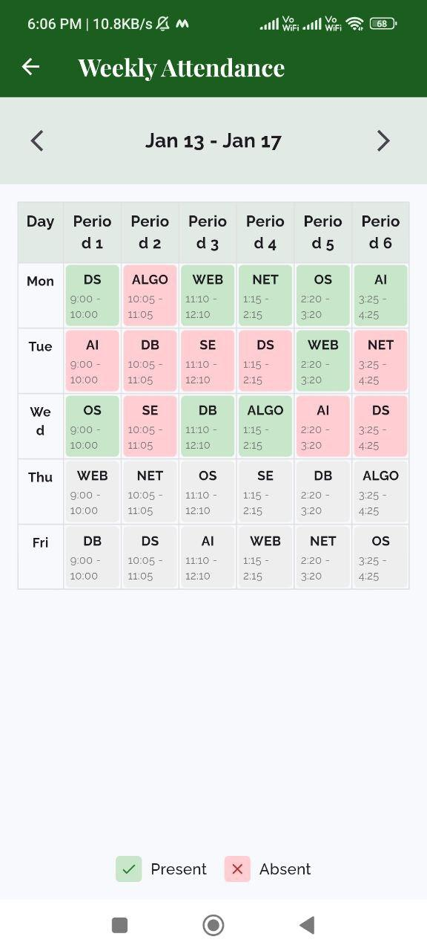
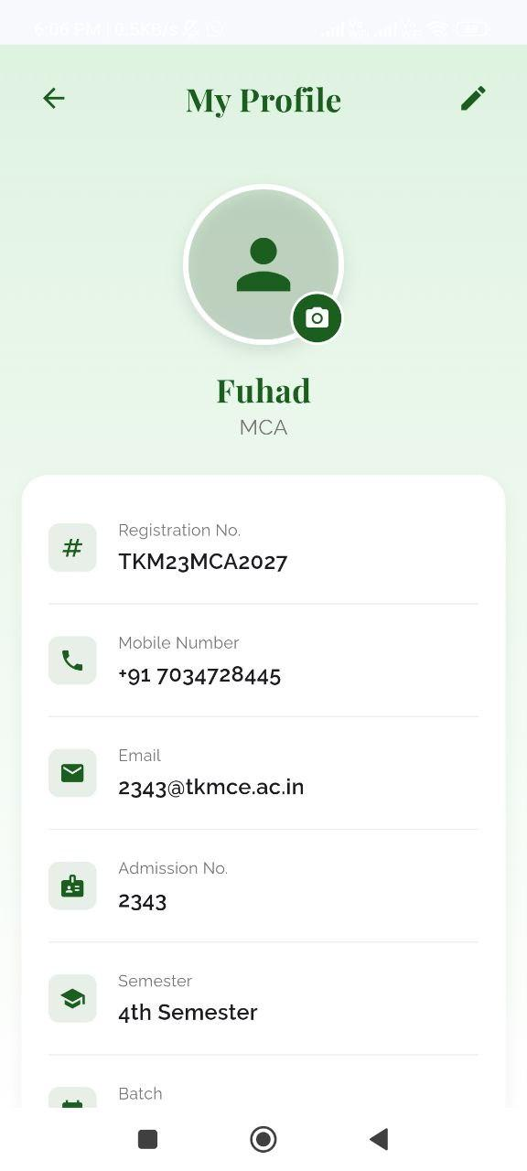

Slide 12
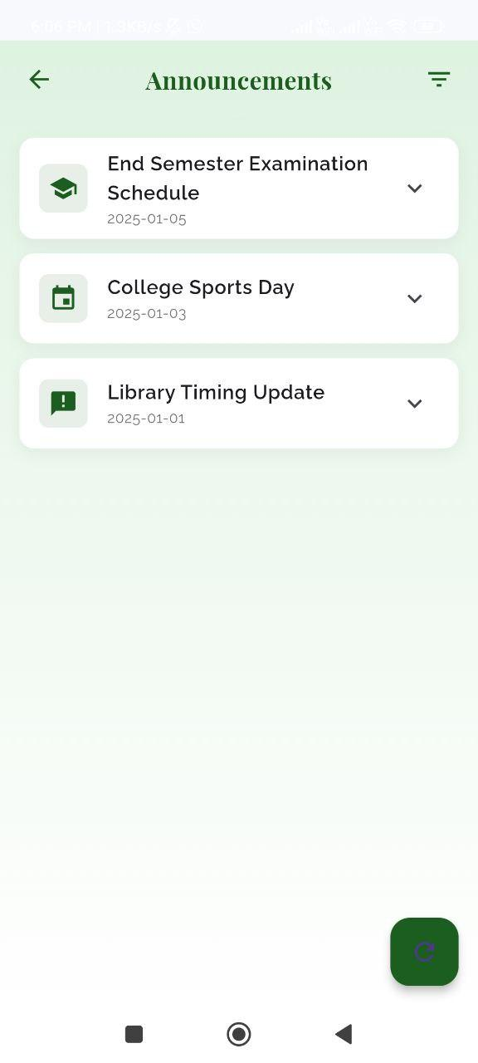
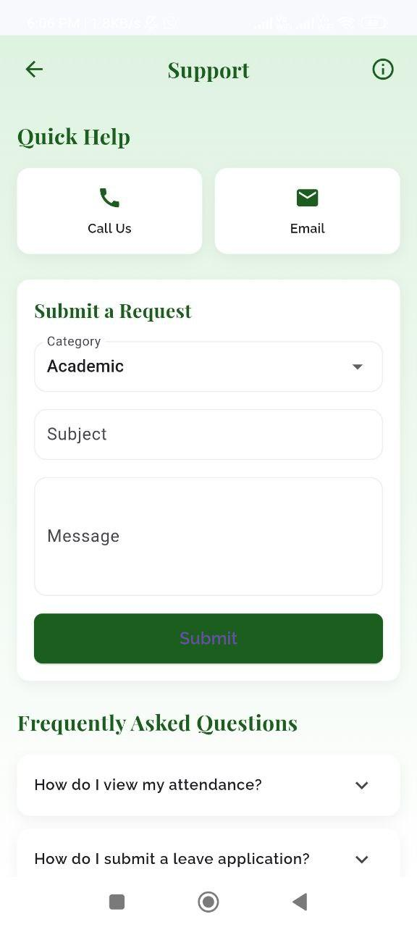
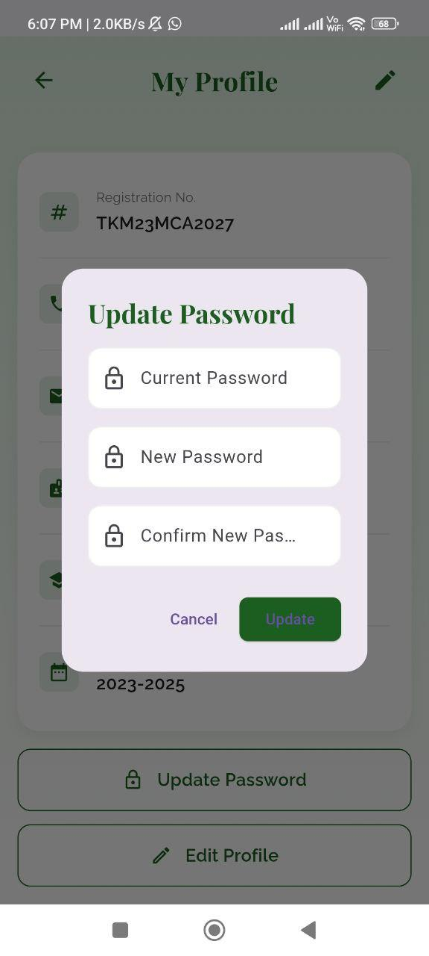

Slide 13
Conclusion
The proposed system overcomes current limitations with a user-friendly interface, offline functionality, and scalability, ensuring efficient and accessible attendance management.
Simplifies Attendance Management
1
User-friendly platform for students and teachers.
Enhances Efficiency
2
Reduces errors, real-time data access.

Slide 14
REFERENCE
A. Kumar and B. Singh, "Smart Attendance Management System Using Mobile Applications," in IEEE Transactions on Education Technology, vol. 5, no. 3, pp. 123-130, Mar. 2021.
J. Smith and A. Doe, "Cloud-Based Attendance System Using Mobile Apps," in IEEE Journal of Educational Computing, vol. 7, no. 2, pp. 98-105, Apr. 2022.
M. Chen and L. Zhang, "Mobile Application Development for Academic Attendance Tracking," in IEEE International Conference on Mobile Computing, pp. 45-52, June 2021.
S. Patel and R. Gupta, "Digital Transformation in Education: Implementing Mobile-Based Attendance Systems," in IEEE Conference on Educational Technology Integration, pp. 210-217, Aug. 2022.

Slide 15
THANK YOU
Reference Section
1. Gamma, "AI-Powered Presentation and Visual Creation Tool," [Online]. Available: https://gamma.app..
2. Anthropic, "Claude AI: A Conversational AI Assistant," [Online]. Available: https://www.anthropic.com.

